Slide 1
Projects’ workflow for reproducibility and replicability using R PART 2 – Computational reproducibility
Second Rostock Open Science Workshop, MPIDR, Rostock 17-18 March 2025
Egor Kotov & Jonas Schöley

Slide 2

Building blocks of computational reproducibility
Lock R packages and specific versions
Logos by respective copyright holders

Slide 3

Building blocks of computational reproducibility
Lock R packages and specific versions
Reproducible analysis workflow
Logos by respective copyright holders

Slide 4



Building blocks of computational reproducibility
Lock R packages and specific versions
Reproducible analysis workflow
Complete computational environment
Logos by respective copyright holders

Slide 5







Building blocks of computational reproducibility
Lock R packages and specific versions
Reproducible analysis workflow
Complete computational environment
Logos by respective copyright holders

Slide 6
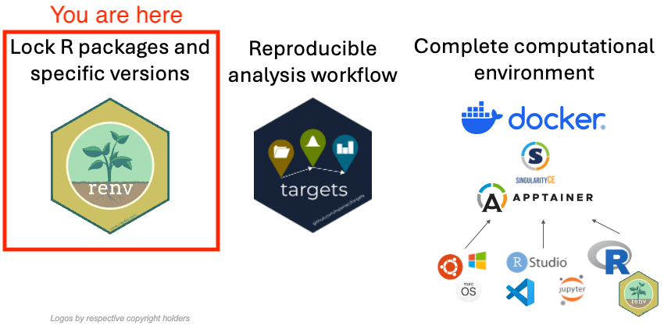
renv: PACKAGE VERSION CONTROL

Slide 7
renv: PACKAGE VERSION CONTROL
/bin/R/library (base R packages)
OS
Logos by respective copyright holders

Slide 8
renv: PACKAGE VERSION CONTROL
/users/u1/R/library (user installed R pkgs)
/bin/R/library (base R packages)
OS
Logos by respective copyright holders

Slide 9
renv: PACKAGE VERSION CONTROL
📂/users/u1/projects/01/ (ordinary R project)
/users/u1/R/library (user installed R pkgs)
/bin/R/library (base R packages)
OS
Logos by respective copyright holders

Slide 10
renv: PACKAGE VERSION CONTROL
📂/users/u1/projects/01/ (ordinary R project)
/users/u1/R/library (user installed R pkgs)
/bin/R/library (base R packages)
OS
/users/u1/home/.cache/renv/
Logos by respective copyright holders

Slide 11
renv: PACKAGE VERSION CONTROL
📂/users/u1/projects/01/ (ordinary R project)
/users/u1/R/library (user installed R pkgs)
/bin/R/library (base R packages)
OS
/users/u1/home/.cache/renv/
📂 /users/u1/projects/02/renv/library
📂 /users/u1/projects/03/renv/library
Logos by respective copyright holders

Slide 12
renv: PACKAGE VERSION CONTROL
📂/users/u1/projects/01/ (ordinary R project)
/users/u1/R/library (user installed R pkgs)
/bin/R/library (base R packages)
OS
/users/u1/home/.cache/renv/
📂 /users/u1/projects/02/renv/library
📂 /users/u1/projects/03/renv/library
Logos by respective copyright holders

Slide 13
renv: PACKAGE VERSION CONTROL
dplyr 1.1.4
📂/users/u1/projects/01/ (ordinary R project)
/users/u1/R/library (user installed R pkgs)
dplyr 1.1.4
/bin/R/library (base R packages)
OS
/users/u1/home/.cache/renv/
📂 /users/u1/projects/02/renv/library
📂 /users/u1/projects/03/renv/library
Logos by respective copyright holders

Slide 14
renv: PACKAGE VERSION CONTROL
dplyr 1.1.4
📂/users/u1/projects/01/ (ordinary R project)
/users/u1/R/library (user installed R pkgs)
dplyr 1.1.4
/bin/R/library (base R packages)
OS
dplyr 0.8.3 dplyr 0.7.5
/users/u1/home/.cache/renv/
dplyr 0.7.5
📂 /users/u1/projects/02/renv/library
📂 /users/u1/projects/03/renv/library
dplyr 0.8.3
Logos by respective copyright holders

Slide 15
renv: PACKAGE VERSION CONTROL
/bin/R/library (base R packages)
📂 /users/u1/projects/02/renv/library
OS
/users/u1/home/.cache/renv/
Logos by respective copyright holders

Slide 16
renv: PACKAGE VERSION CONTROL
/bin/R/library (base R packages)
📂 /users/u1/projects/02/renv/library
OS
renv::init()
renv takes over the package installation
/users/u1/home/.cache/renv/
Logos by respective copyright holders

Slide 17
renv: PACKAGE VERSION CONTROL
/bin/R/library (base R packages)
📂 /users/u1/projects/02/renv/library
OS
install.packages()
and
work as usual
/users/u1/home/.cache/renv/
Logos by respective copyright holders

Slide 18
renv: PACKAGE VERSION CONTROL
/bin/R/library (base R packages)
📂 /users/u1/projects/02/renv/library
OS
renv::snapshot()
👇
save all used packages and their versions
/users/u1/home/.cache/renv/
Logos by respective copyright holders

Slide 19
renv: PACKAGE VERSION CONTROL
/bin/R/library (base R packages)
📂 /users/USER3/projects/02/renv/library
OS
renv::restore()
👇
install required package versions
/users/USER3/home/.cache/renv/
Logos by respective copyright holders

Slide 20
renv: PACKAGE VERSION CONTROL
/bin/R/library (base R packages)
📂 /users/USER3/projects/02/renv/library
OS
renv::restore()
👇
install required package versions
☝️
...which is not always possible
/users/USER3/home/.cache/renv/
Logos by respective copyright holders

Slide 21
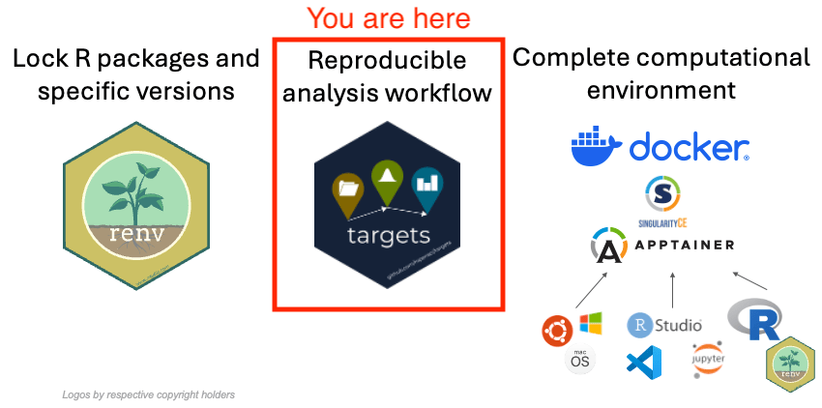
targets: analysis workflow

Slide 22
targets: analysis workflow
library(targets)
tar_dir({
tar_script({
library(targets)
list(
tar_target(mtcars_data,
mtcars),
tar_target(mpg_mean,
mean(mtcars_data$mpg)),
tar_target(plot_mpg,
ggplot2::qplot(mpg,data=mtcars_data))
)}, ask = FALSE)
tar_visnetwork()
})

Slide 23
targets: analysis workflow
library(targets)
tar_dir({
tar_script({
library(targets)
list(
tar_target(mtcars_data,
mtcars),
tar_target(mpg_mean,
mean(mtcars_data$mpg)),
tar_target(plot_mpg,
ggplot2::qplot(mpg,data=mtcars_data))
)}, ask = FALSE)
tar_visnetwork()
})
👈 function saves result to
👈 function saves result to
☝️ function saves result to

Slide 24
targets: analysis workflow
library(targets)
tar_dir({
tar_script({
library(targets)
list(
tar_target(mtcars_data,
mtcars),
tar_target(mpg_mean,
mean(mtcars_data$mpg)),
tar_target(plot_mpg,
ggplot2::qplot(mpg,data=mtcars_data))
)}, ask = FALSE)
tar_visnetwork()
})

Slide 25
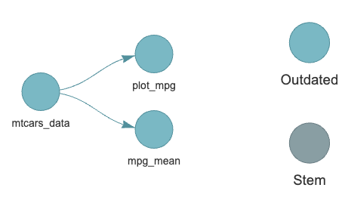
targets: analysis workflow
library(targets)
tar_dir({
tar_script({
library(targets)
list(
tar_target(mtcars_data,
mtcars),
tar_target(mpg_mean,
mean(mtcars_data$mpg)),
tar_target(plot_mpg,
ggplot2::qplot(mpg,data=mtcars_data))
)}, ask = FALSE)
tar_visnetwork()
})

Slide 26
targets: analysis workflow
library(targets)
tar_dir({
tar_script({
library(targets)
list(
tar_target(mtcars_data,
mtcars),
tar_target(mpg_mean,
mean(mtcars_data$mpg)),
tar_target(plot_mpg,
ggplot2::qplot(mpg,data=mtcars_data))
)}, ask = FALSE)
tar_visnetwork()
})

Slide 27
targets: analysis workflow
library(targets)
tar_dir({
tar_script({
library(targets)
list(
tar_target(mtcars_data,
mtcars),
tar_target(mpg_mean,
mean(mtcars_data$mpg)),
tar_target(plot_mpg,
ggplot2::qplot(mpg,data=mtcars_data))
)}, ask = FALSE)
tar_visnetwork()
})

Slide 28
targets: analysis workflow
library(targets)
tar_dir({
tar_script({
library(targets)
list(
tar_target(mtcars_data,
mtcars),
tar_target(mpg_mean,
mean(mtcars_data$mpg)),
tar_target(plot_mpg,
ggplot2::qplot(mpg,data=mtcars_data))
)}, ask = FALSE)
tar_visnetwork()
})

Slide 29
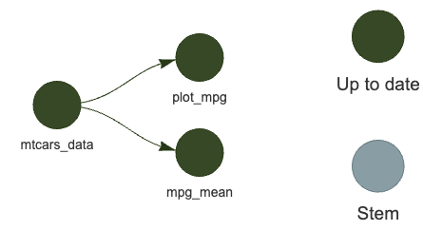
targets: analysis workflow
library(targets)
tar_dir({
tar_script({
library(targets)
list(
tar_target(mtcars_data,
mtcars),
tar_target(mpg_mean,
mean(mtcars_data$mpg)),
tar_target(plot_mpg,
ggplot2::qplot(mpg,data=mtcars_data))
)}, ask = FALSE)
tar_make(); tar_visnetwork()
})
targets::tar_make() 👈 run all steps

Slide 30
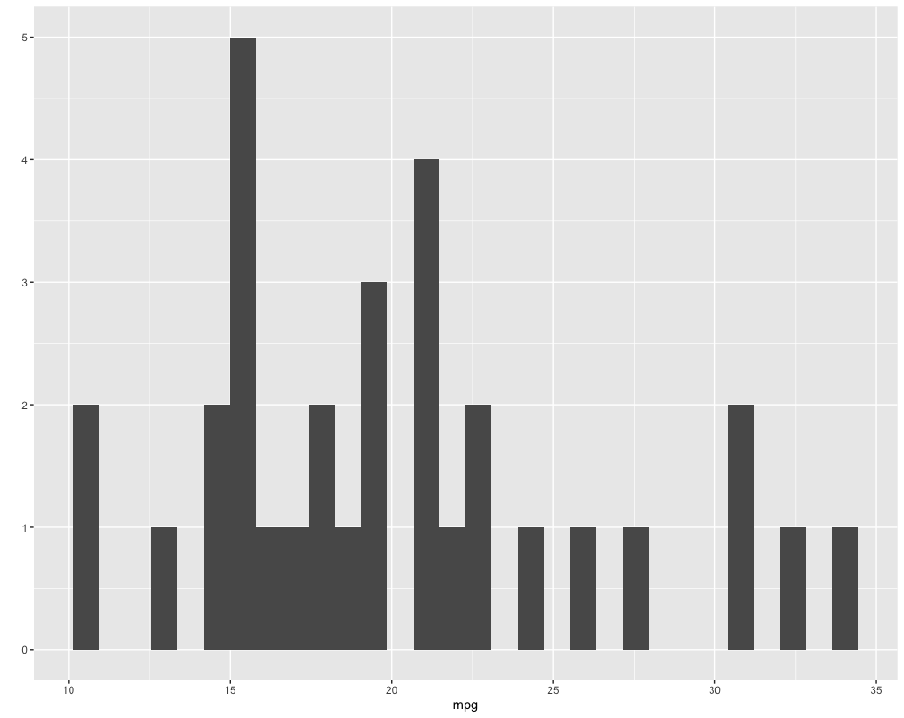
targets: analysis workflow
library(targets)
tar_dir({
tar_script({
library(targets)
list(
tar_target(mtcars_data,
mtcars),
tar_target(mpg_mean,
mean(mtcars_data$mpg)),
tar_target(plot_mpg,
ggplot2::qplot(mpg,data=mtcars_data))
)}, ask = FALSE)
tar_make(); tar_read(plot_mpg)
})
targets::tar_read() 👈 view step results

Slide 31
targets: project structure
library(targets)
list(
tar_target(output1,
function_1() ),
tar_target(output2,
function_2(input1 = output1) ),
tar_target(output3,
function_3(input1 = output1,
input 2 = output2) ),
)

Slide 32
targets: project structure
library(targets)
list(
tar_target(output1,
function_1() ),
tar_target(output2,
function_2(input1 = output1) ),
tar_target(output3,
function_3(input1 = output1,
input 2 = output2) ),
)
/rpoject01
_targets.R
R/
01_scripts.R
02_scripts.R
...
_targets/
objects/

Slide 33
targets: project structure
library(targets)
list(
tar_target(output1,
function_1() ),
tar_target(output2,
function_2(input1 = output1) ),
tar_target(output3,
function_3(input1 = output1,
input 2 = output2) ),
)
/rpoject01
_targets.R
R/
01_scripts.R
02_scripts.R
...
_targets/
objects/

Slide 34
targets: project structure
library(targets)
list(
tar_target(output1,
function_1() ),
tar_target(output2,
function_2(input1 = output1) ),
tar_target(output3,
function_3(input1 = output1,
input 2 = output2) ),
)
/rpoject01
_targets.R
R/
01_scripts.R
02_scripts.R
...
_targets/
objects/

Slide 35
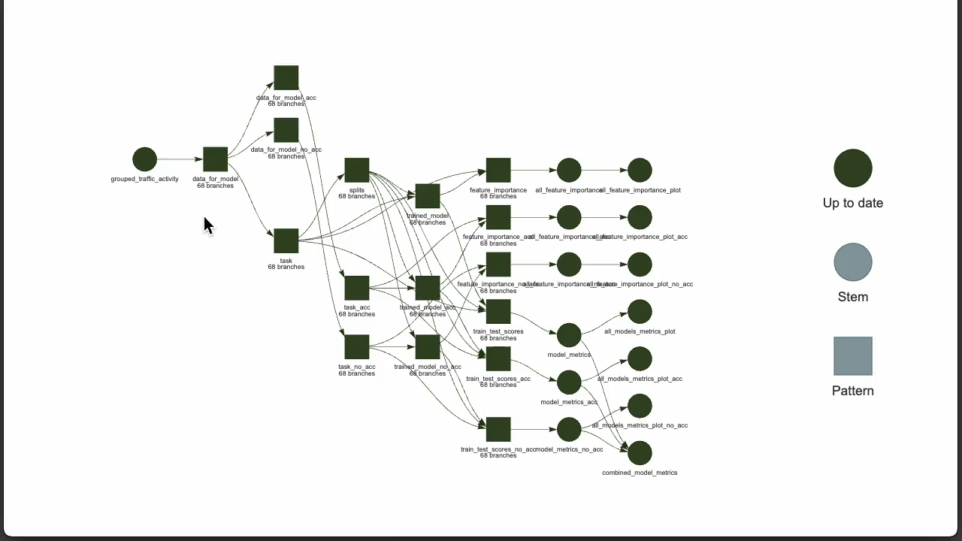
targets: COMPLEX Workflow EXAMPLE

Slide 36
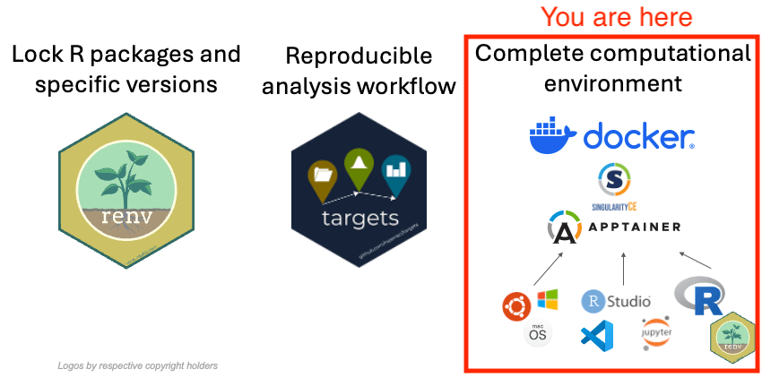
containers: environment preservation

Slide 37
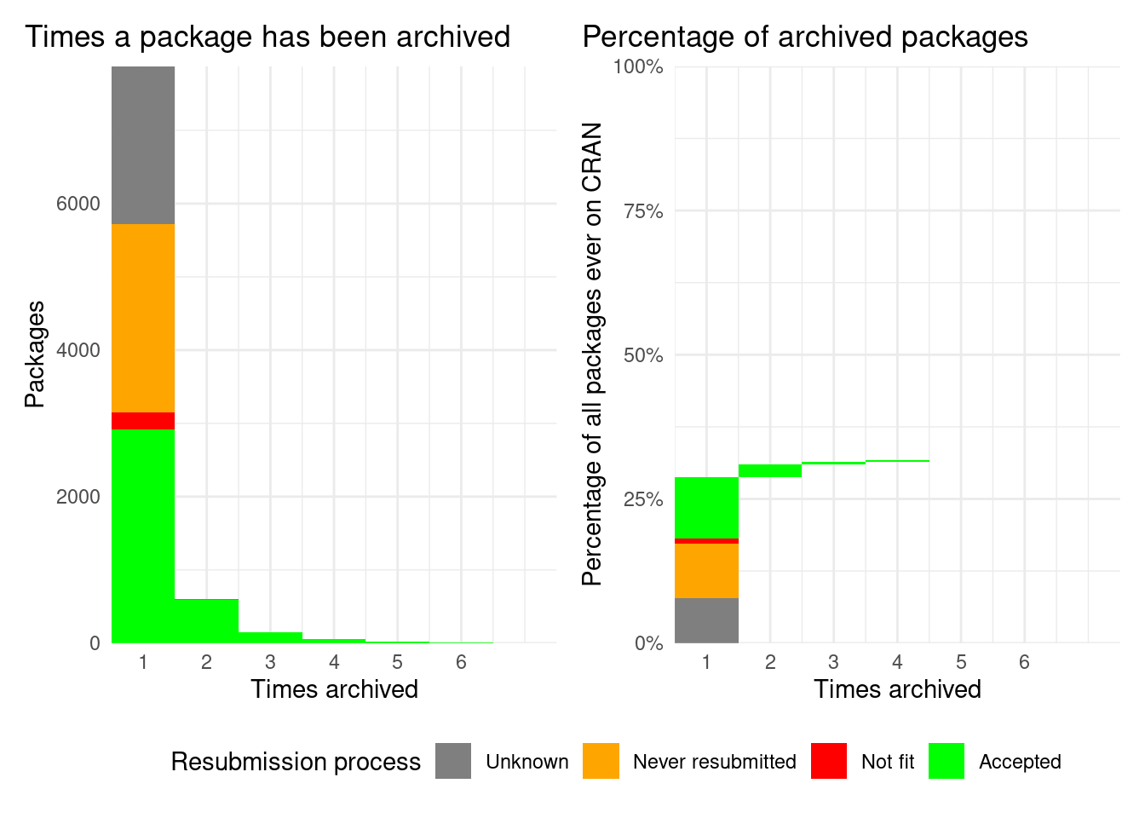
40% of all packages ever in CRAN got at one point archived
Source: https://www.cranhaven.org/cran-archiving-stats.htm

Slide 38
40% of all packages ever in CRAN got at one point archived
👈 Thousands on of packages are NEVER BACK ON CRAN!
Source: https://www.cranhaven.org/cran-archiving-stats.htm

Slide 39
renv: PACKAGE VERSION CONTROL
/bin/R/library (base R packages)
📂 /users/USER3/projects/02/renv/library
OS
renv::restore()
👇
install required package versions
☝️
...which is not always possible
/users/USER3/home/.cache/renv/
Logos by respective copyright holders

Slide 40
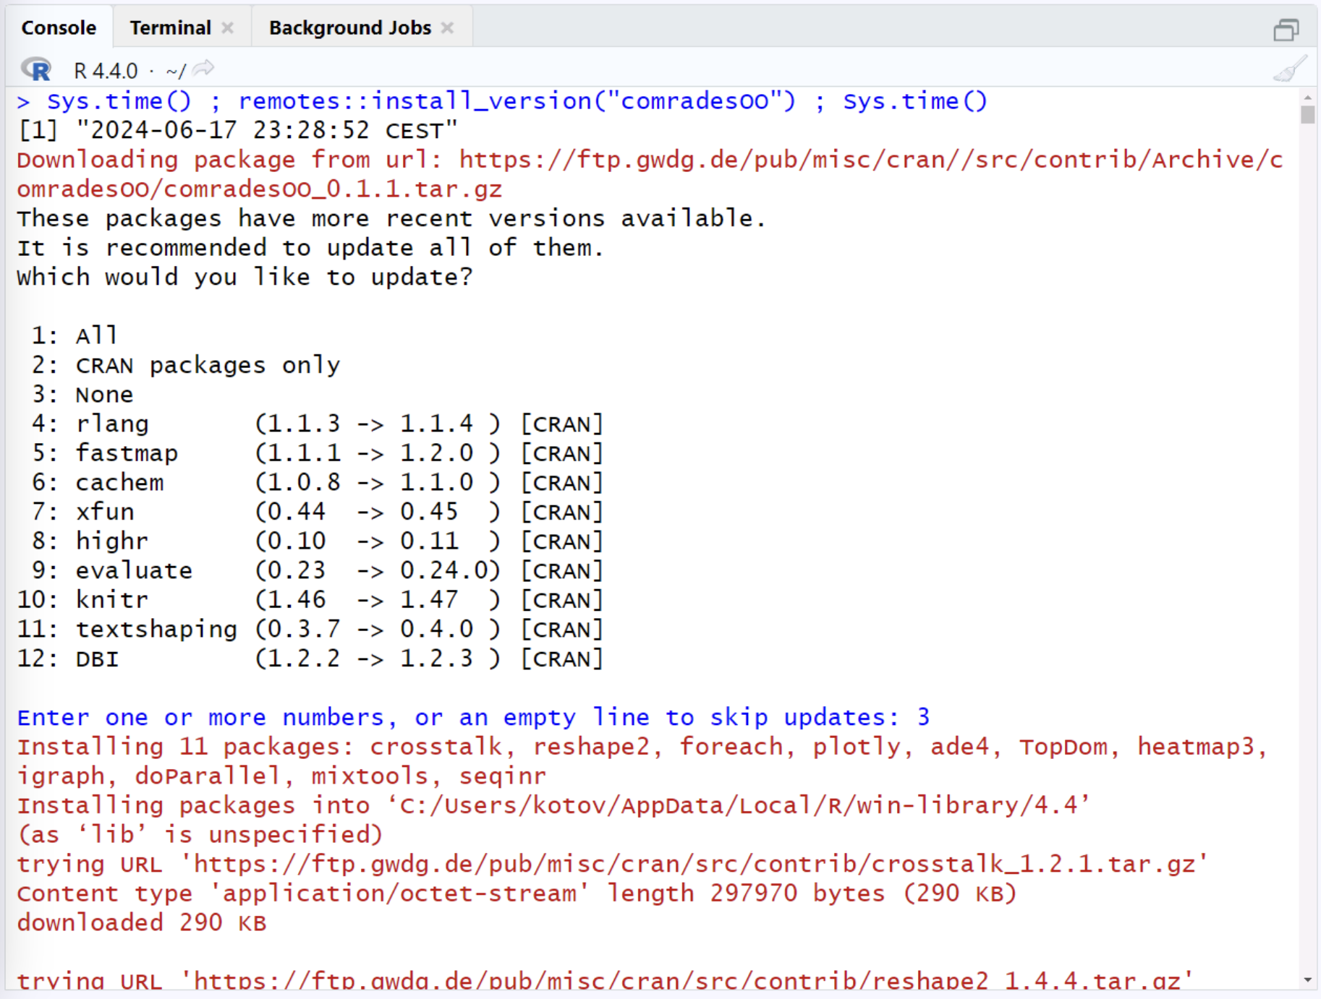
remotes::install_version()

Slide 42


Slide 43
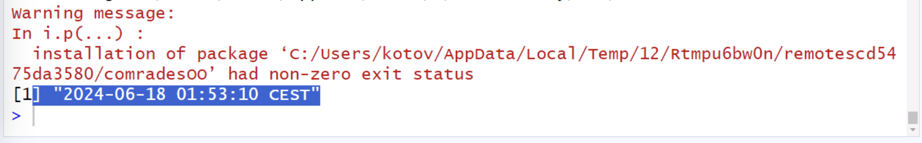
2.5 hours later of building from source
the package is NOT installed

Slide 44
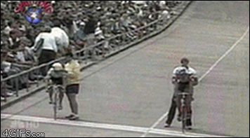
Installing archived packages and their dependencies using
remotes::install_version()
Running R (or Python) in containers

Slide 45
Installing archived packages and their dependencies using
remotes::install_version()
Running R (or Python) in containers

Slide 46
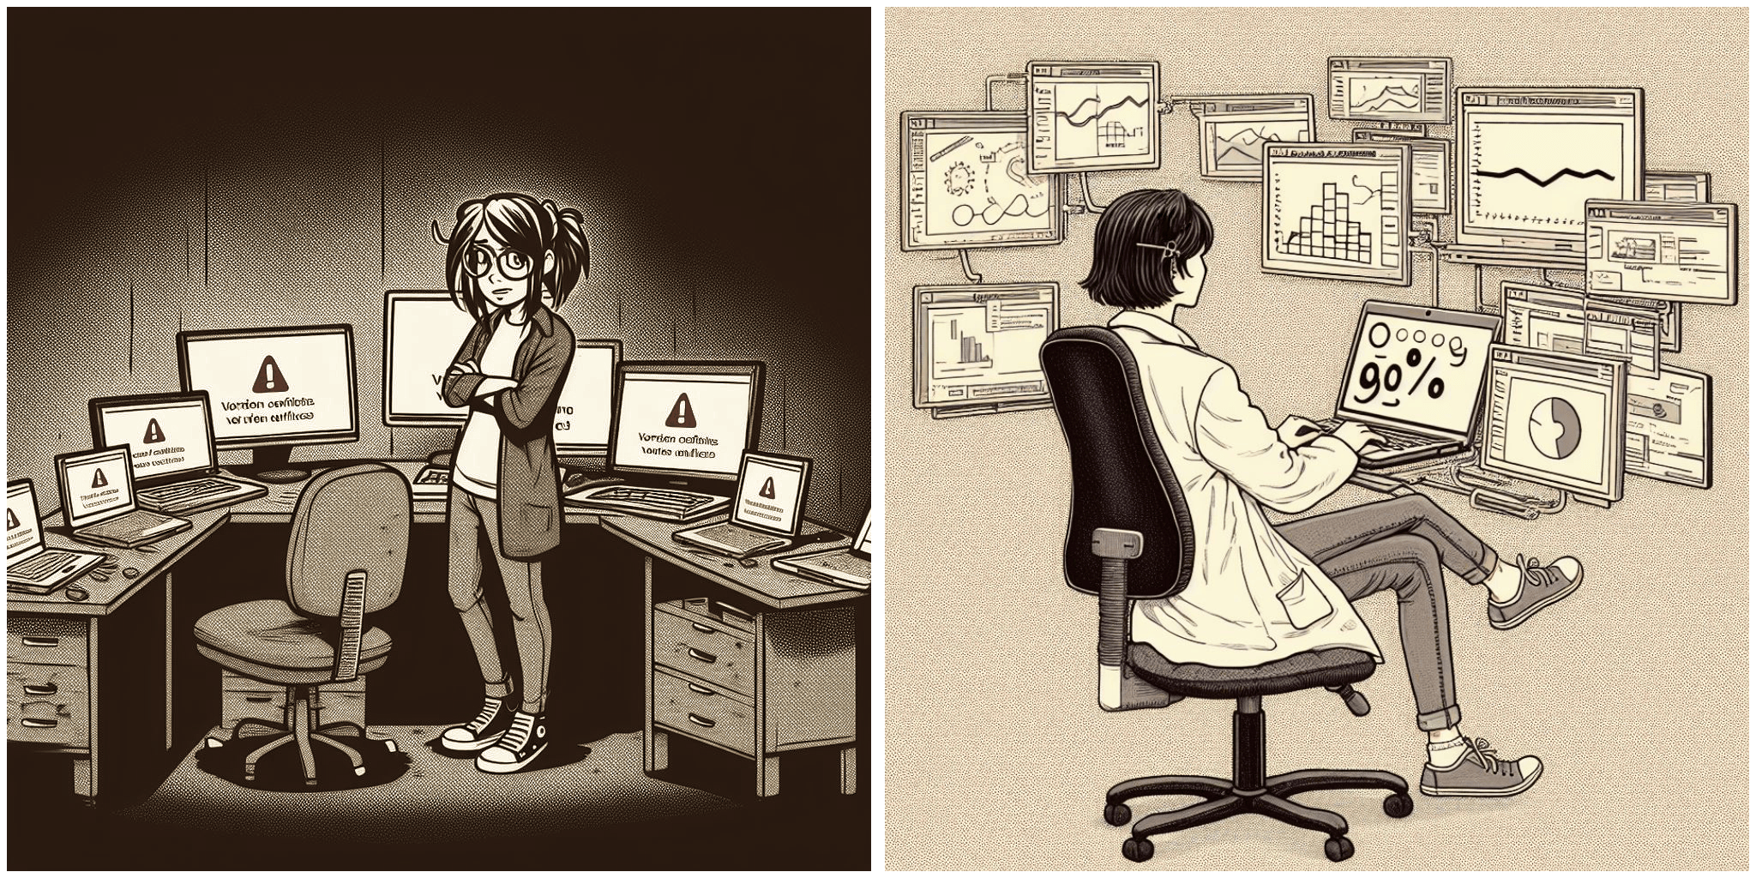
Containers for more consistent workflow
Image generated by Microsoft Image Creator powered by DALL-E 3 Kotov, E., and Denecke, E. (2024). Expanding the Lifespan of Software for Demographic Analysis with Containers: An Application of Spatial Sampling. The Denominator, Population Dynamics Lab. https://doi.org/10.6069/WY8K-D973

Slide 47
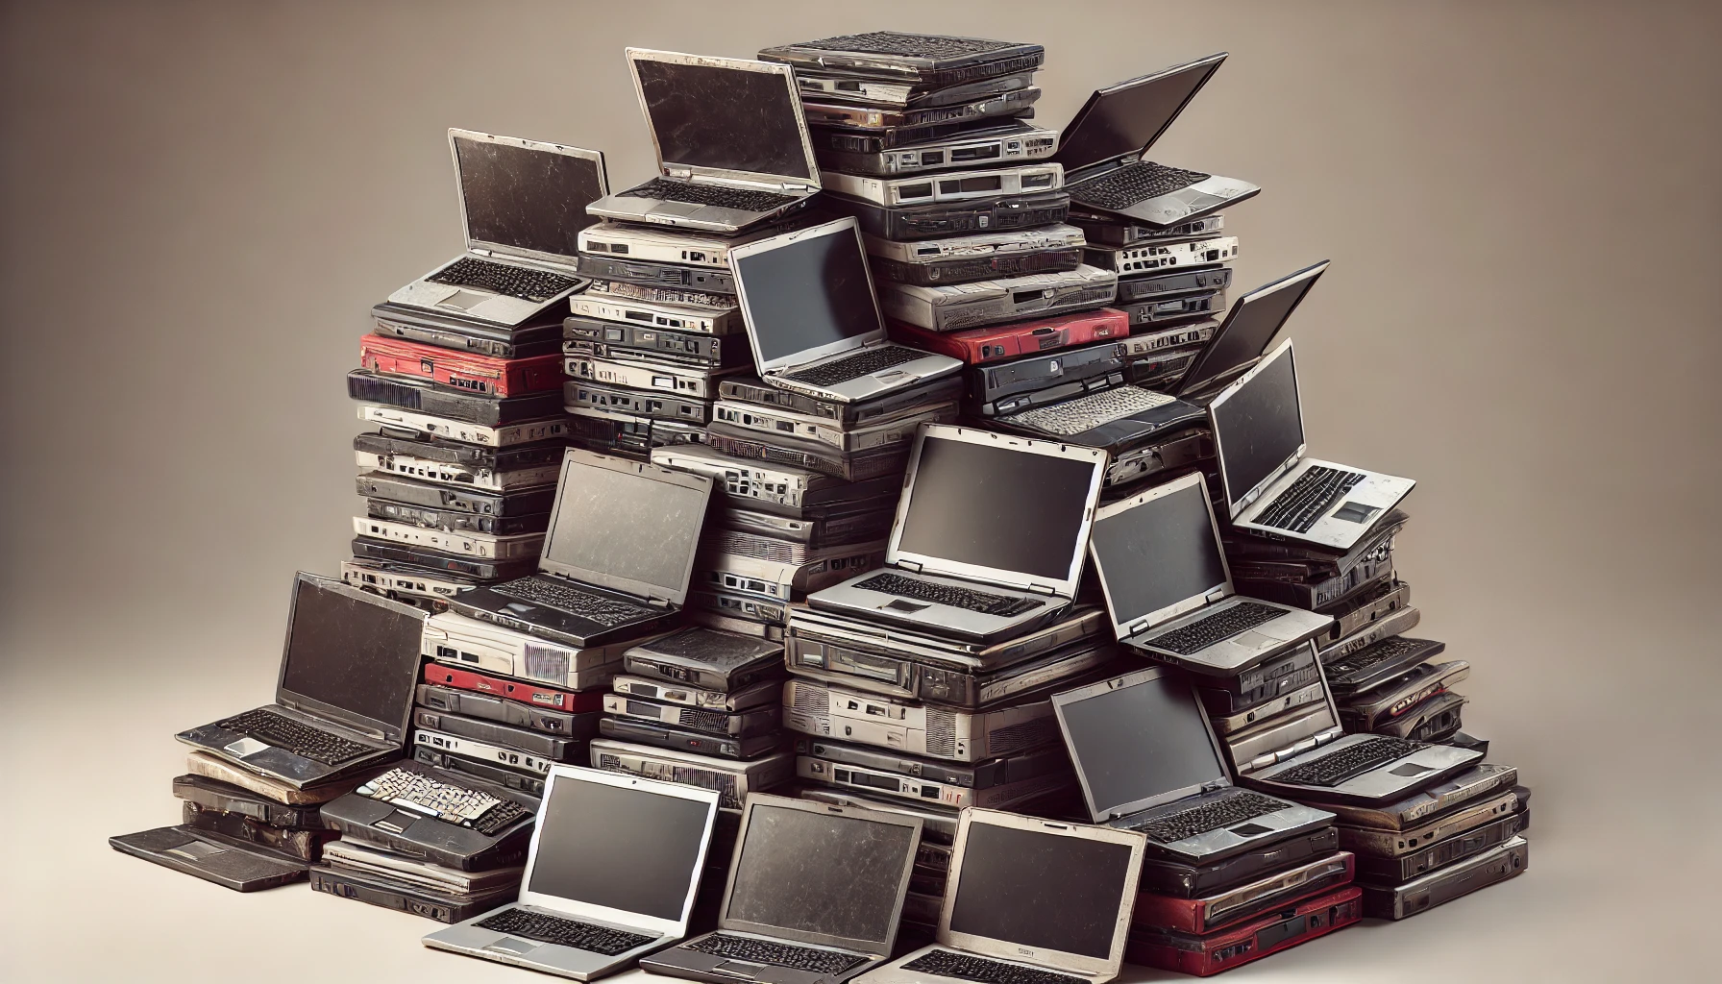
What are containers?
Laptop for Project 1
Laptop for Project 2
Laptop for Project …
Image by DALL-E

Slide 48
What are containers?
Hey, I want to run your code!
Image by DALL-E

Slide 49
What are containers?
Hey, I want to run your code!
Sure, I’ll send you my laptop #45 via DHL. Just give me a week to find which one it is.
Image by DALL-E

Slide 50
What are containers?
Project_1_OS+Rstudio+R+Packages.zip
Image by DALL-E

Slide 51


What are containers?
Logos by respective copyright holders

Slide 52
What are containers?
Logos by respective copyright holders

Slide 53
What are containers?
That would take a lot of time…
Logos by respective copyright holders

Slide 54
What are containers?
Ubuntu operating system (or another Linux)
Logos by respective copyright holders

Slide 55
What are containers?
R or any other analytics software
Ubuntu operating system (or another Linux)
Logos by respective copyright holders

Slide 56
What are containers?
RStudio or any other code editor
R or any other analytics software
Ubuntu operating system (or another Linux)
Logos by respective copyright holders

Slide 57
What are containers?
Any other software, scripts, files, anything!
RStudio or any other code editor
R or any other analytics software
Ubuntu operating system (or another Linux)
Logos by respective copyright holders

Slide 58
Software to build and run containers
Most popular, widely known
Windows/macOS/Linux
Many compatible alternative software
Logos by respective copyright holders

Slide 59
Software to build and run containers
Often used in academic HPCs
Mostly Linux
Can import Docker containers
Most popular, widely known
Windows/macOS/Linux
Many compatible alternative software
Logos by respective copyright holders

Slide 60

Software to build and run containers
Often used in academic HPCs
Mostly Linux
Can import Docker containers
Most popular, widely known
Windows/macOS/Linux
Many compatible alternative software
Run small containers (1-2 GB memory)
In the cloud, for free
Based on Docker
Logos by respective copyright holders

Slide 61
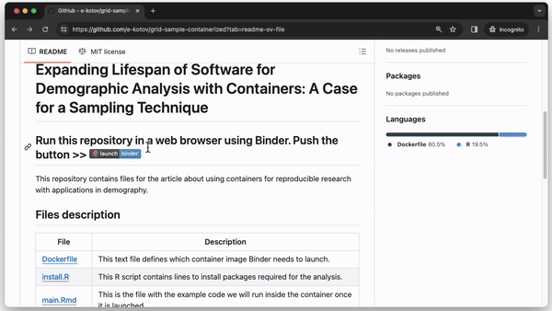
Running Analysis in a container @ mybinder.org
Kotov, E., and Denecke, E. (2024). Expanding the Lifespan of Software for Demographic Analysis with Containers: An Application of Spatial Sampling. The Denominator, Population Dynamics Lab. https://doi.org/10.6069/WY8K-D973 || repo https://github.com/Population-Dynamics-Lab/grid-sample-containerized

Slide 62
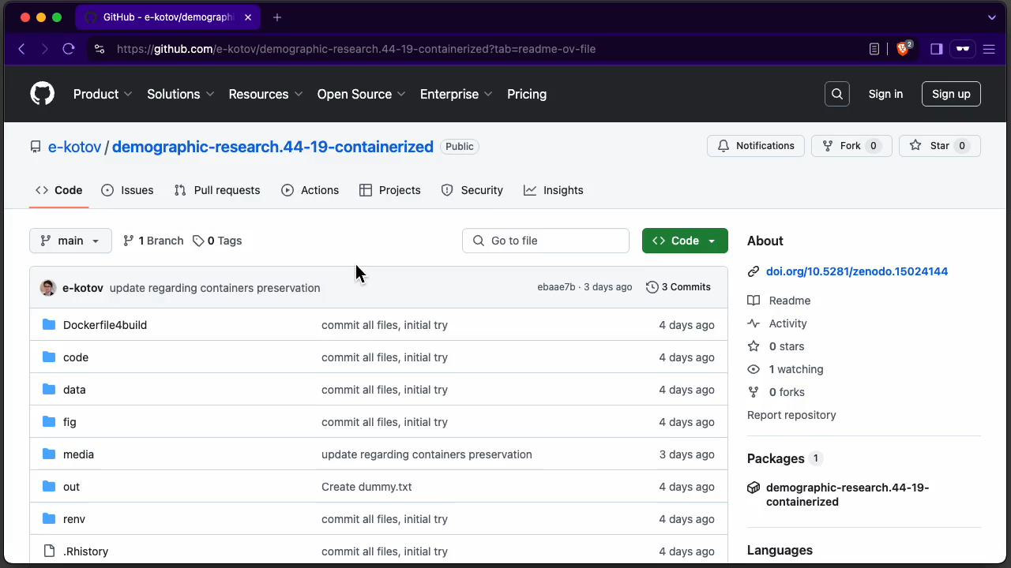
Running Analysis in a container @ mybinder.org
Schöley, J., 2021. The centered ternary balance scheme: A technique to visualize surfaces of unbalanced three-part compositions. Demographic Research 44, 443–458. https://doi.org/10.4054/DemRes.2021.44.19 Repo link: https://github.com/e-kotov/demographic-research.44-19-containerized

Slide 63
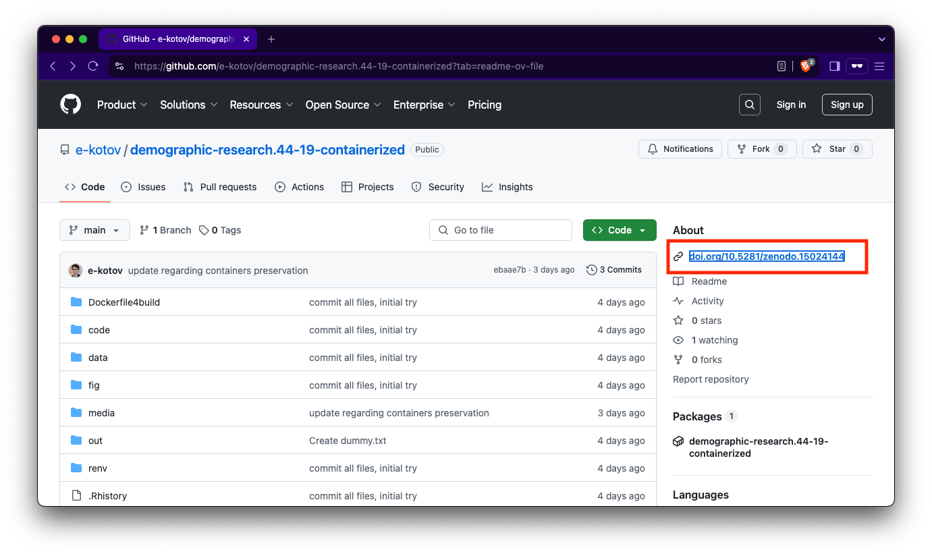
Preserving the computational environment
Schöley, J., 2021. The centered ternary balance scheme: A technique to visualize surfaces of unbalanced three-part compositions. Demographic Research 44, 443–458. https://doi.org/10.4054/DemRes.2021.44.19 Repo link: https://github.com/e-kotov/demographic-research.44-19-containerized

Slide 64
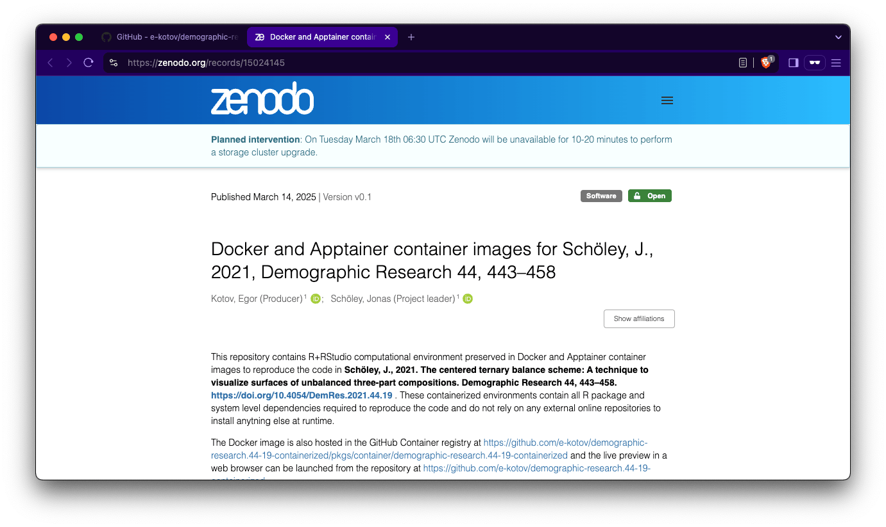
Preserving the computational environment
Schöley, J., 2021. The centered ternary balance scheme: A technique to visualize surfaces of unbalanced three-part compositions. Demographic Research 44, 443–458. https://doi.org/10.4054/DemRes.2021.44.19 Repo link: https://github.com/e-kotov/demographic-research.44-19-containerized

Slide 65
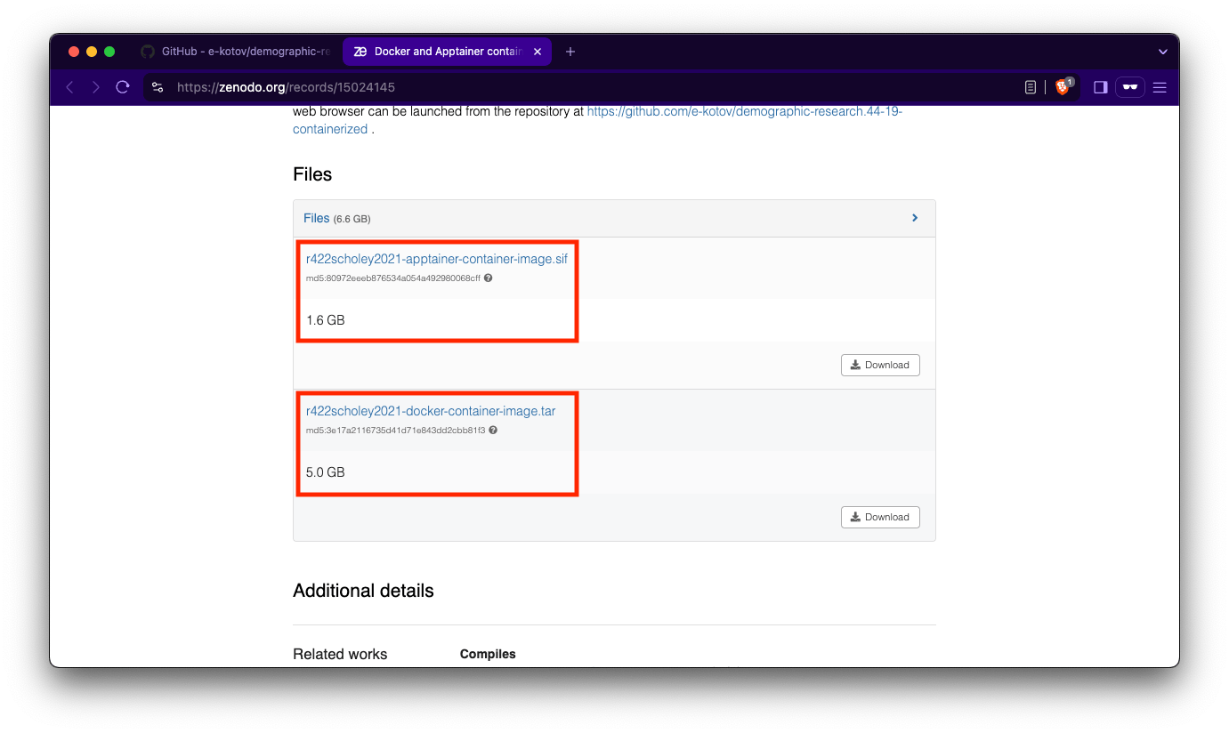
Preserving the computational environment
Schöley, J., 2021. The centered ternary balance scheme: A technique to visualize surfaces of unbalanced three-part compositions. Demographic Research 44, 443–458. https://doi.org/10.4054/DemRes.2021.44.19 Repo link: https://github.com/e-kotov/demographic-research.44-19-containerized ; Logos by respective copyright holders

Slide 66

With containers you are free to run Any software, no need to BOTHER YOUR IT
Image from The I.T Crowd C4 TV Show For the record, this is not in any way representative of the IT team at MPIDR or GWDG HPC

Slide 67

WHERE TO GET CONTAINERS?
Icons and search bar by Google, but feel free to use other search engines

Slide 68
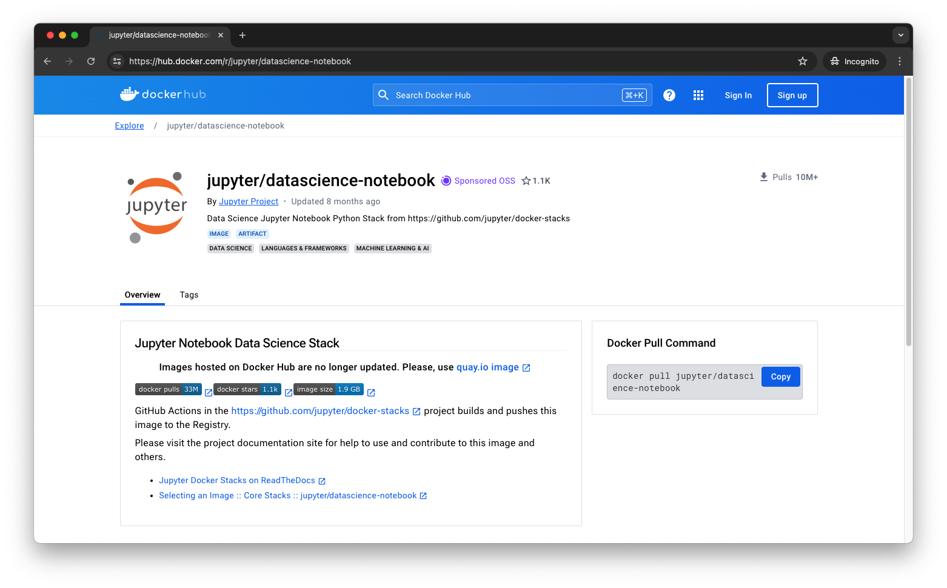
WHERE TO GET CONTAINERS?
https://hub.docker.com/r/jupyter/datascience-notebook

Slide 69
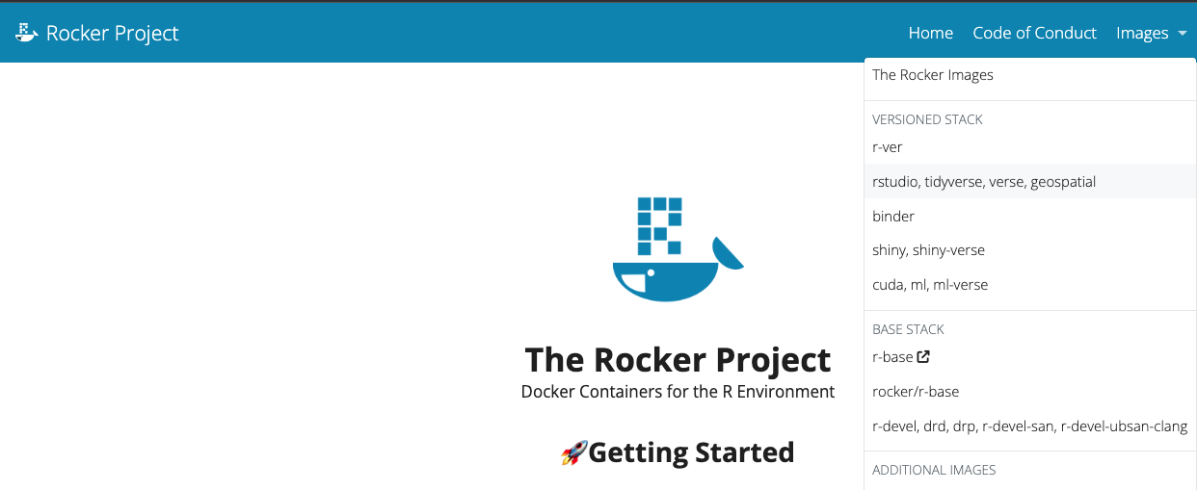
WHERE TO GET CONTAINERS?
Source: https://rocker-project.org/

Slide 70
Vanilla R
Source: https://rocker-project.org/

Slide 71
Vanilla R
Various packages preinstalled
Source: https://rocker-project.org/

Slide 72
Vanilla R
Various packages preinstalled
geospatial + specially designed for mybinder.org, has most popular packages
Source: https://rocker-project.org/

Slide 73
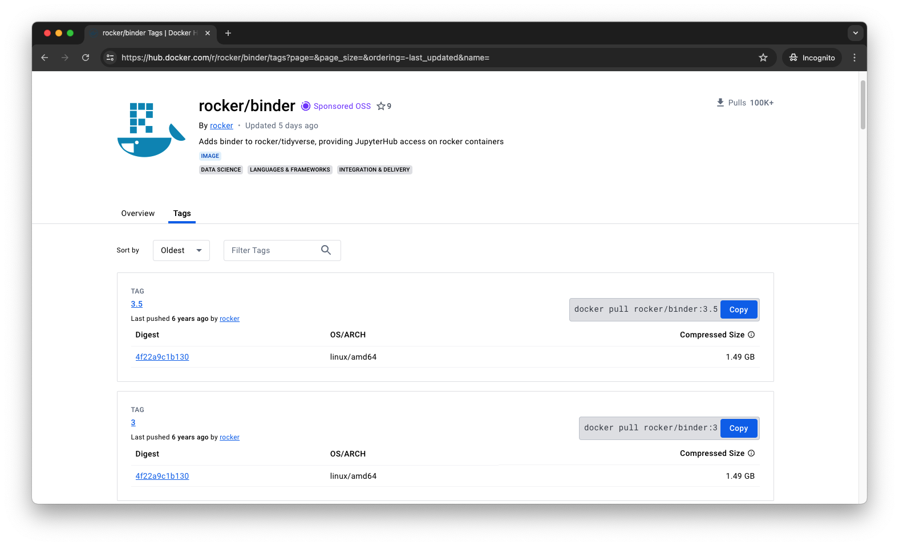
WHERE TO GET CONTAINERS?
Find the R version you need, perhaps considering the release date of this specific version
Find the R version you need, perhaps considering the release date of this specific version
https://hub.docker.com/r/jupyter/datascience-notebook

Slide 74
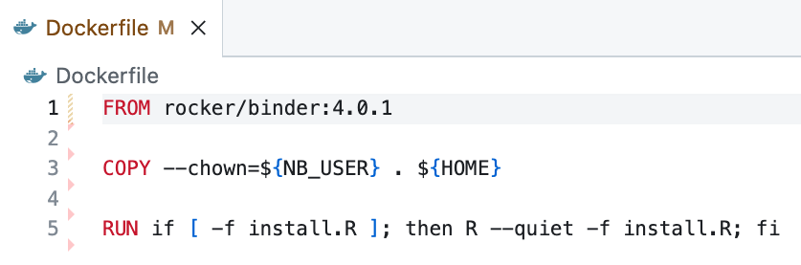
4. Example: DESIGN AND BUILD Containers
Which pre-built container to use

Slide 75
4. Example: DESIGN AND BUILD Containers
Which pre-built container to use
Copy all files in the same directory into the container

Slide 76
4. Example: DESIGN AND BUILD Containers
Which pre-built container to use
Copy all files in the same directory into the container
Run R script to install packages

Slide 77
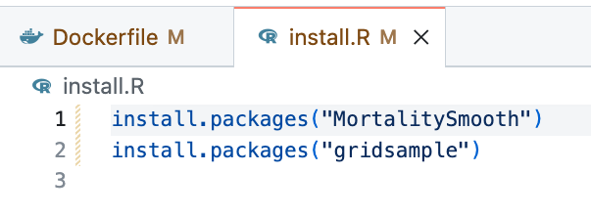
4. Example: DESIGN AND BUILD Containers

Slide 78

Egor Kotov
Ph.D. Student
Laboratory of Migration and Mobility
kotov@demogr.mpg.de
Jonas Schöley
Research Scientist
Laboratory of Population Health
schoeley@demogr.mpg.de

